Slide 1

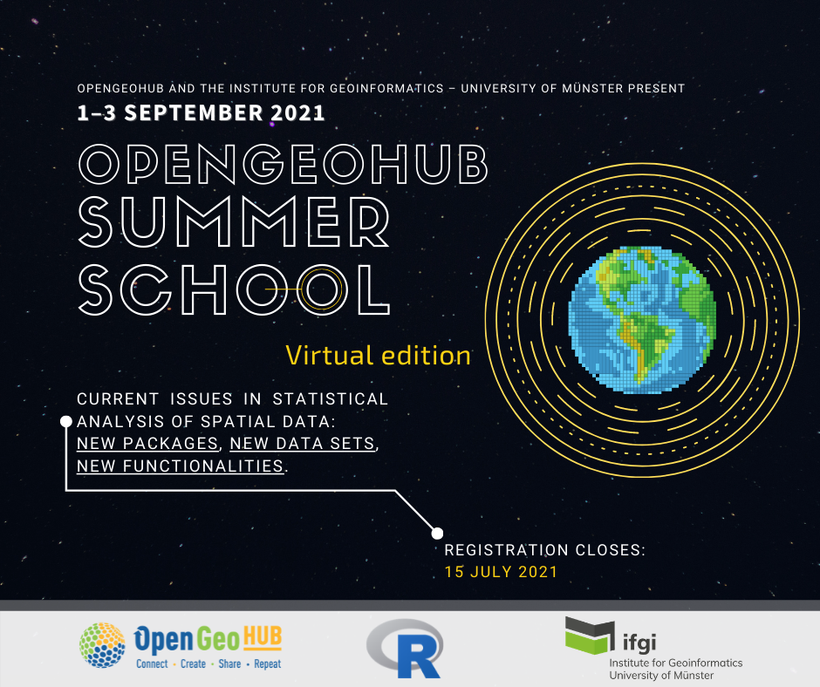
SITS: Satellite Image Time Series Analysis for Big Earth Observation Data
Gilberto Câmara, Rolf Simões and Felipe Souza
INPE (National Institute for Space Research, Brazil)

Slide 2




The zero download model
Space agencies
Software
open data
Results
Users
Cloud platforms
Notes:
Essa quantidade massiva de dados e a adoção de políticas de dados abertos por várias agências espaciais tem tornado disponível uma quantidade sem precedentes de dados para a comunidade.
Uma tendência observada nos últimos anos é o armazenamento e a disponibilização desses repositórios na nuvem.
Uma consequência imediata é o uso de plataformas de processamento na nuvem que fiquem próximas dos dados.
Os usuários fornecem as instruções na forma de software para serem processadas e obtém os resultados desejados.

Slide 3
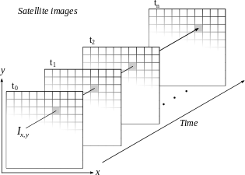
Space-first, time-later or time-first, space-later?
Space-first: classify images separately. Compare results in time
Time-first: classify
time series separately.
Join results to get maps
Notes:
A construção de um sistema para análise de dados de observação da Terra, dada as características aqui mencionadas, se depara com vários desafios e escolhas.
O pacote sits é baseado na abordagem “Time-first, space-later” que se baseia na classificação de séries temporais e se diferencia da abordagem “Space-first, time-later” que se baseia na classificação multitemporal de imagens.
Essa foi uma decisão que estruturou todo o sistema já de partida. O foco do sits é a série temporal.

Slide 4
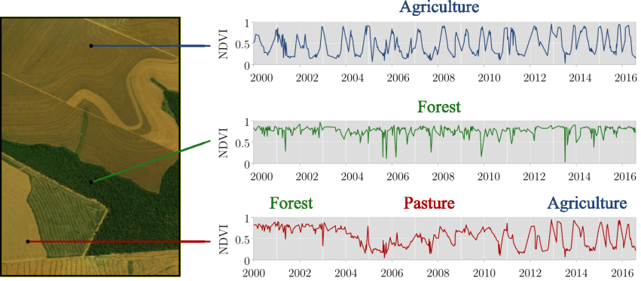
Time series measure change
How to classify land use and land cover using time series?
graphics: Maus, Victor
Notes:
Uma questão que emerge imediatamente como consequência dessa escolha é:
“Como classificar cobertura e uso da Terra usando séries temporais?”
Aqui nessa imagem, nós podemos ver séries temporais de NDVI do sensor MODIS de diferentes localizações entre os anos 2000 e 2016.
Na primeira, constatamos uma série típica de agricultura. Na segunda, uma série típica de cobertura florestal. Na terceira, observamos uma trajetória de mudanças, começando com floresta, depois pastagem e, na sequência, agricultura.

Slide 5
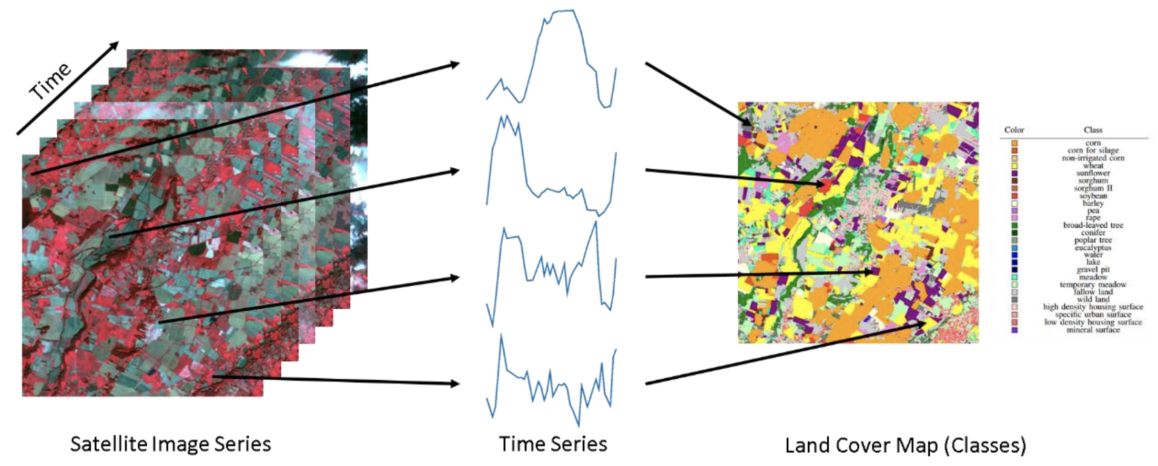
Land classification with image time series
image: F Petitjean, Monash Univ
Notes:
Sits is an R package for Satellite Image Time Series Analysis for Earth Observation Data Cubes.
This package provides a simples API for a complete and complex workflow for land classification from big EO data sets.
It provides funcionalities to:
Create and define earth observation data cubes
Assess and improve land use and cover samples using neural network and Self-Organizing maps (SOM)
Train different kinds of machine learning methods using land use and cover samples
Classify the data cube using the trained model.
Perform some kind of post-processing (such as smoothing) to generate the final map.
Spatial smoothing methods remove outliers from the classification.

Slide 6
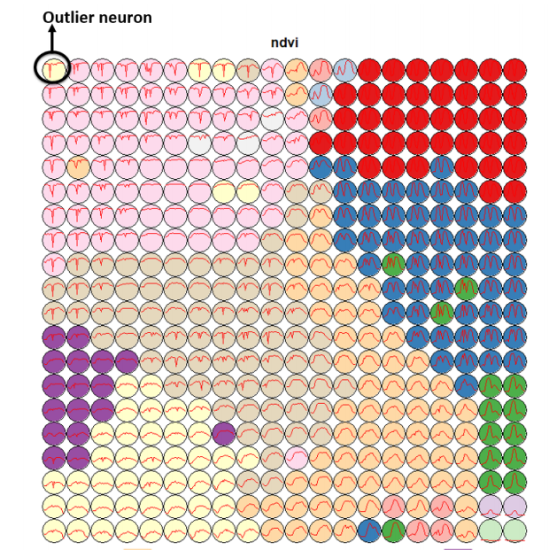
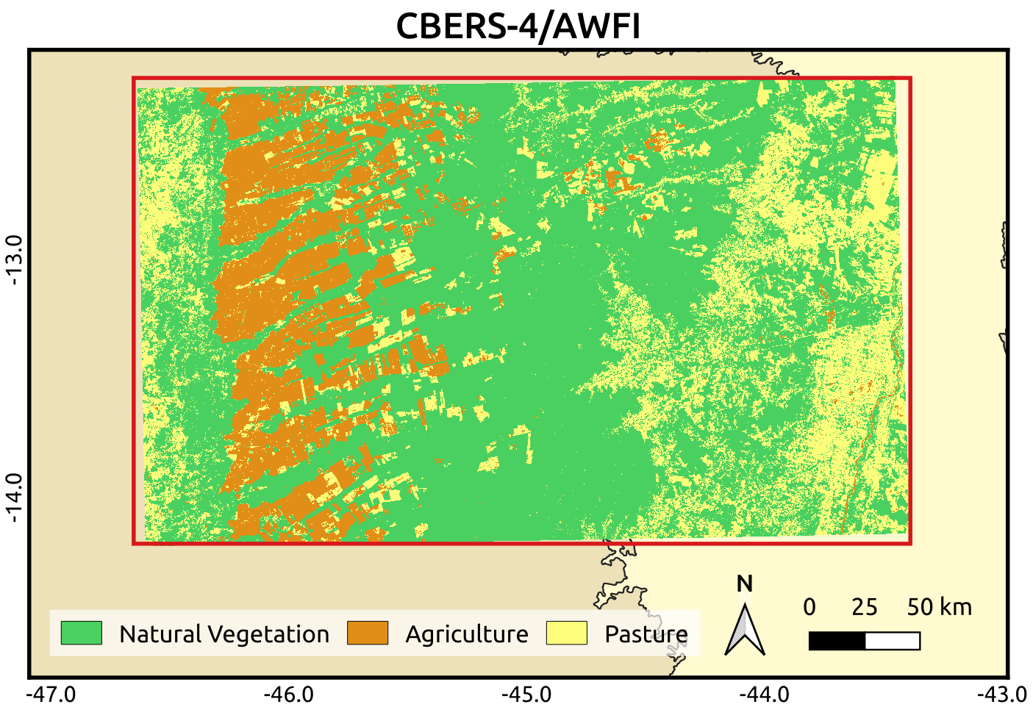
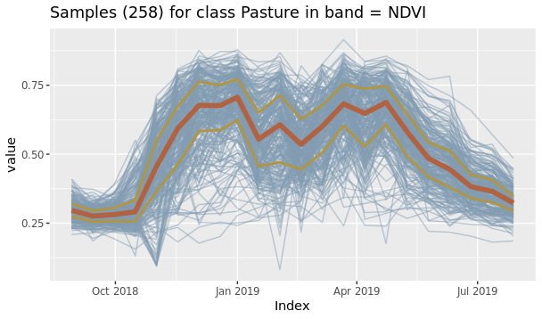
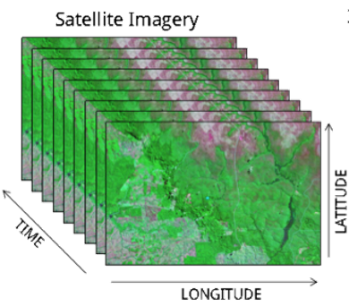

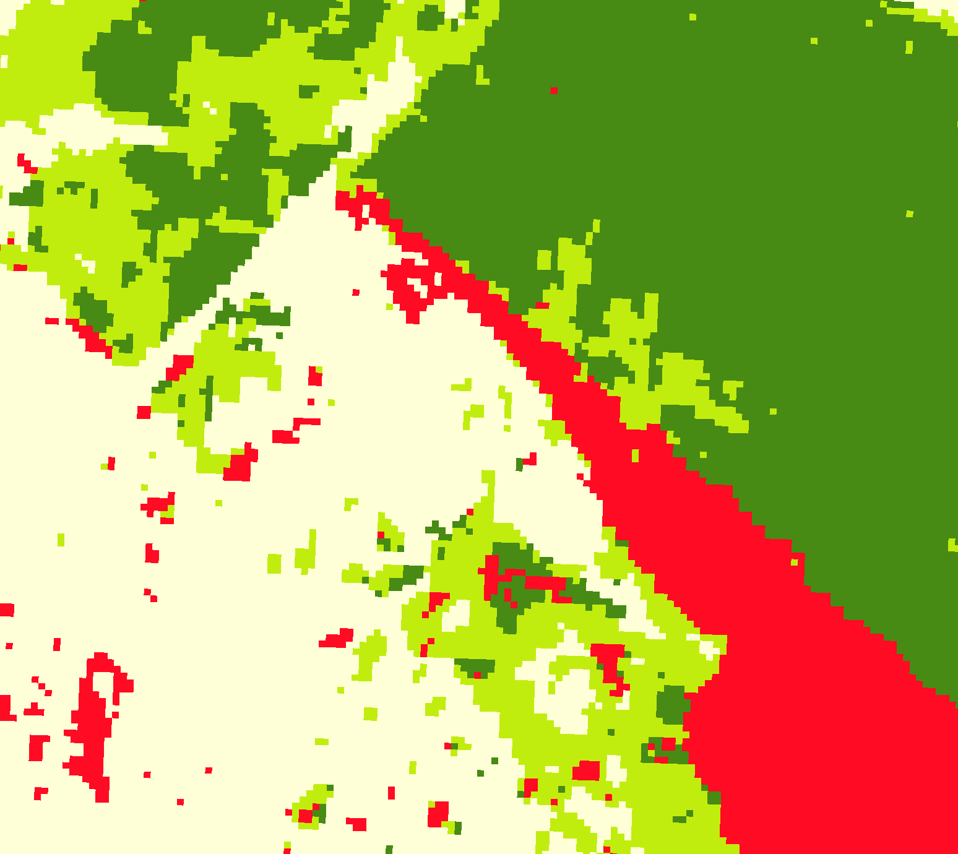
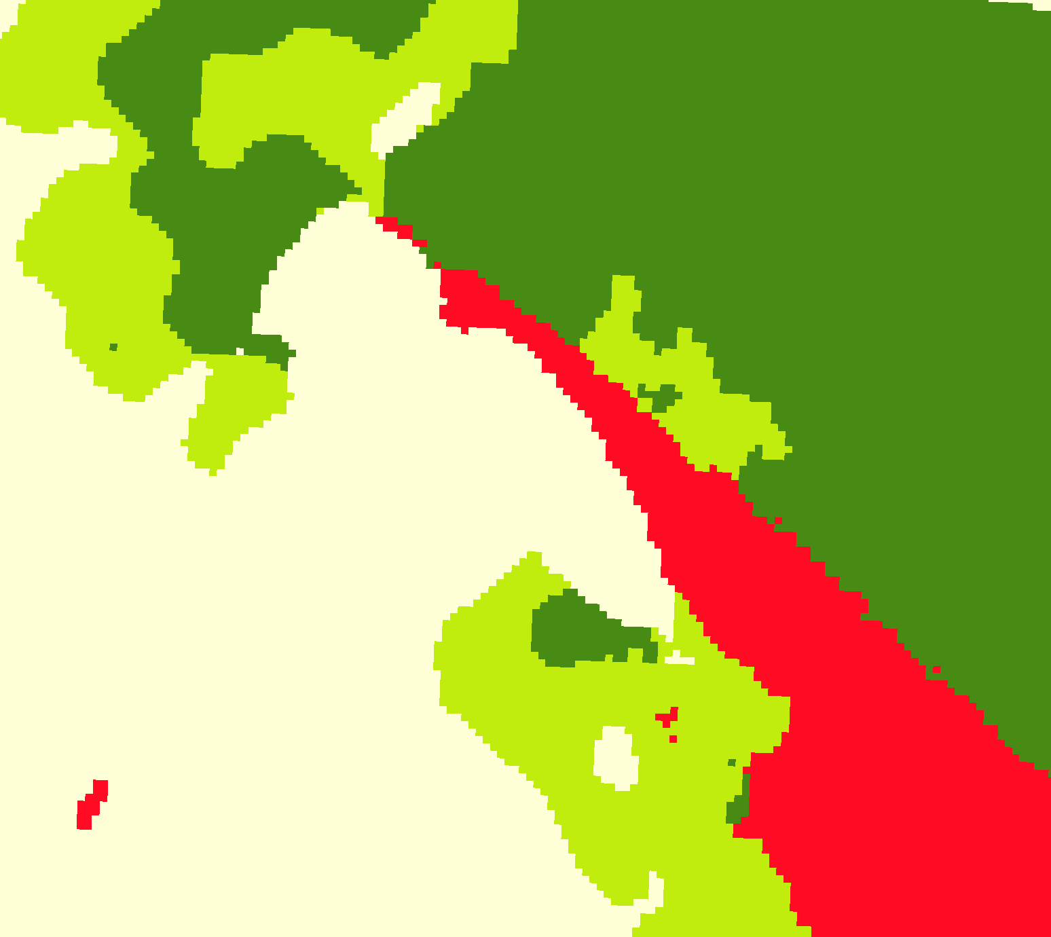
LUCC samples
Quality Analysis
LUCC maps
EO data cubes
ML models
Classification and smoothing
Notes:
Sits is an R package for Satellite Image Time Series Analysis for Earth Observation Data Cubes.
This package provides a simples API for a complete and complex workflow for land classification from big EO data sets.
It provides funcionalities to:
Create and define earth observation data cubes
Assess and improve land use and cover samples using neural network and Self-Organizing maps (SOM)
Train different kinds of machine learning methods using land use and cover samples
Classify the data cube using the trained model.
Perform some kind of post-processing (such as smoothing) to generate the final map.
Spatial smoothing methods remove outliers from the classification.

Slide 7
Complete land classification workflow
LUCC samples
Quality Analysis
LUCC maps
EO data cubes
ML models
Classification and smoothing
Notes:
Sits is an R package for Satellite Image Time Series Analysis for Earth Observation Data Cubes.
This package provides a simples API for a complete and complex workflow for land classification from big EO data sets.
It provides funcionalities to:
Create and define earth observation data cubes
Assess and improve land use and cover samples using neural network and Self-Organizing maps (SOM)
Train different kinds of machine learning methods using land use and cover samples
Classify the data cube using the trained model.
Perform some kind of post-processing (such as smoothing) to generate the final map.
Spatial smoothing methods remove outliers from the classification.

Slide 8
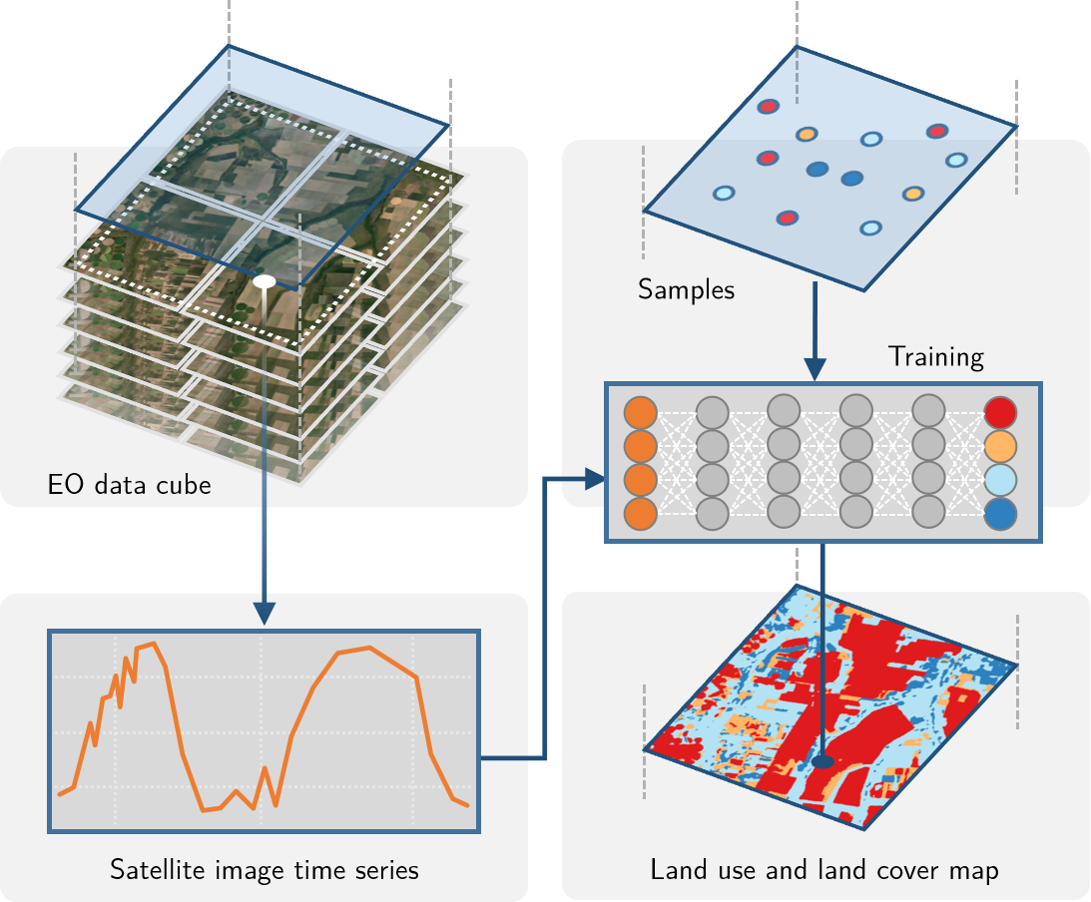
SITS workflow
Notes:
Uma das formas de classificar uma série temporal é passando os dados da série temporal diretamente para algoritmos de aprendizado de máquina.
Primeiramente, as séries temporais devem vir de algum lugar. Conceptualmente, as séries temporais vem de cubos de dados de observação da Terra, que são imagens organizadas que representam as dimensões espaciais (x e y) e a temporal.
Usando amostras que indicam um intervalo de datas e uma localização espacial associados a uma classe de uso e cobertura da Terra, podemos treinar modelos de aprendizado de máquina para gerar mapas de uso e cobertura.

Slide 9
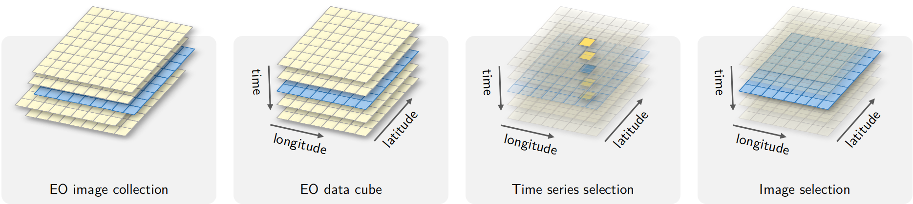
What is an EO data cube?
Data cube = regular partitions of space and time

Slide 10


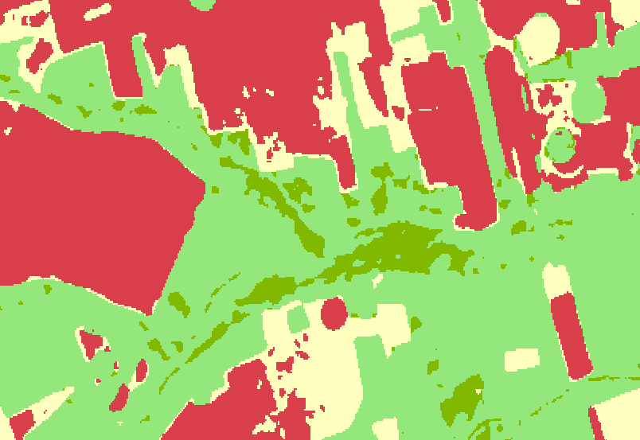
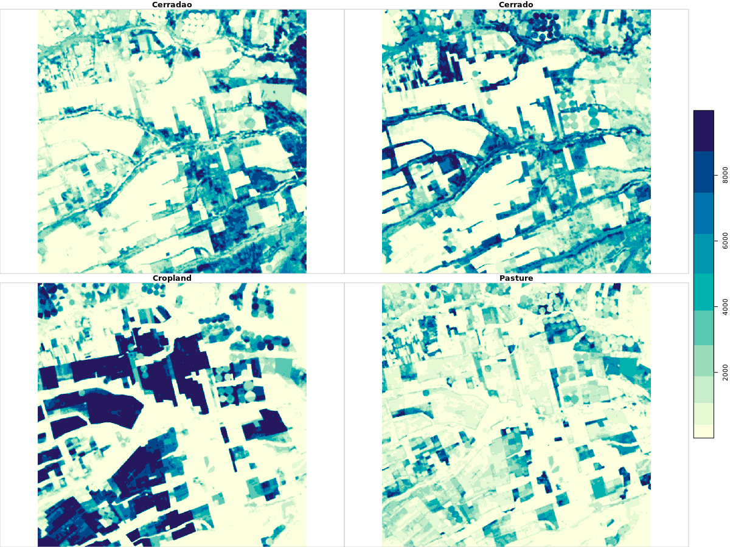

ARD image
collections
Ground truth
cube
label_classification
samples
cube
probs
cube
get_data
classify
smooth
train
model
ML/DL methods
Notes:
O sits fornece uma API simples e intuitiva que realiza essas tarefas. A API se integra com o fluxo de trabalho apresentado anteriormente.
Aqui, podemos ver que seis comandos são necessários para realizar uma classificação. As funções possuem parâmetros default capazes de fornecer bons resultados, o que facilita a obtenção de bons mapas por usuários novos.
Toda a API foi extensamente documentada.

Slide 11






Accessing data cubes with STAC
Digital Earth Africa
Brazil Data Cube
Earth on AWS
SEPAL
AI for Earth
Notes:
O sits é baseado em tecnologias Web para ter acesso às coleções de imagens. O uso do protocolo STAC, do qual falaremos um pouco mais no último capítulo, facilita a interoperabilidade entre diferentes repositórios de dados e plataformas de computação em nuvem.
Atualmente o sits fornece suporte aos dados do Sentinel, Landsat, CBERS e MODIS no projeto BDC, Sentinel-2 e Lansat do repositório Digital Earth Africa na AWS e do Sentinel-2 da AWS.
Estamos desenvolvendo o suporte para os repositórios da AI for Earth da Microsoft e o ambiente de cloud da SEPAL.

Slide 12
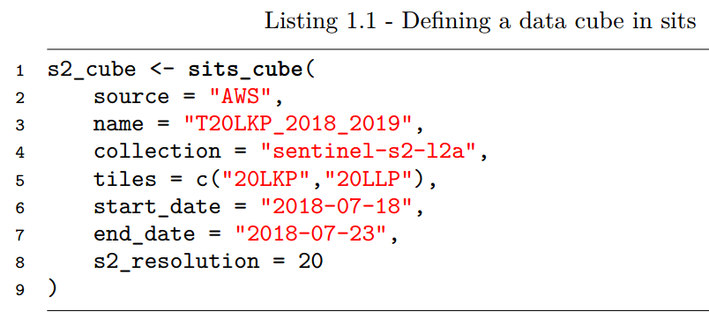

Slide 13
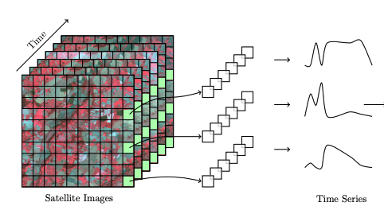
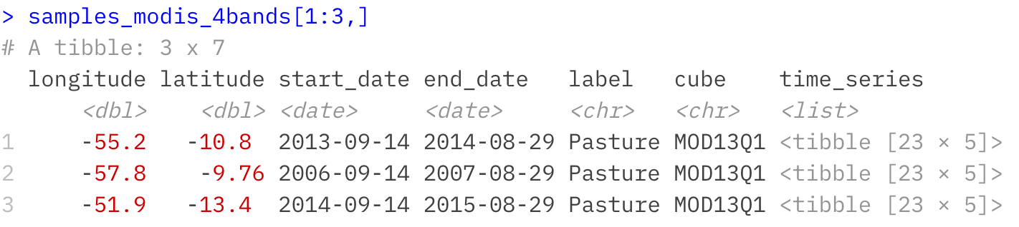
Image time series samples as R objects
Notes:
Sits provides data structures to represent in R EO data cube and image time series.

Slide 14
Are our samples good?
Alves et al., “Quality control and class noise reduction of satellite image time series”, ISPRS Journal of Photogrammetry and Remote Sensing, vol. 177, pp 75-88, 2021

Slide 15
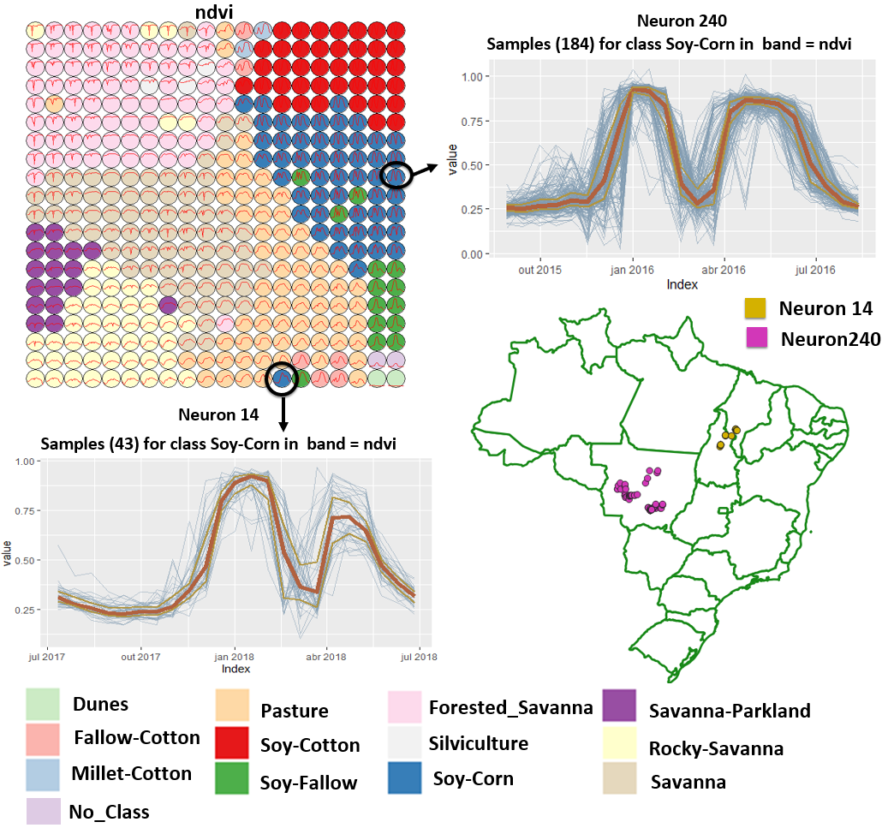
Using SOM to assess sample quality
Alves et al., “Quality control and class noise reduction of satellite image time series”, ISPRS Journal of Photogrammetry and Remote Sensing, vol. 177, pp 75-88, 2021

Slide 16
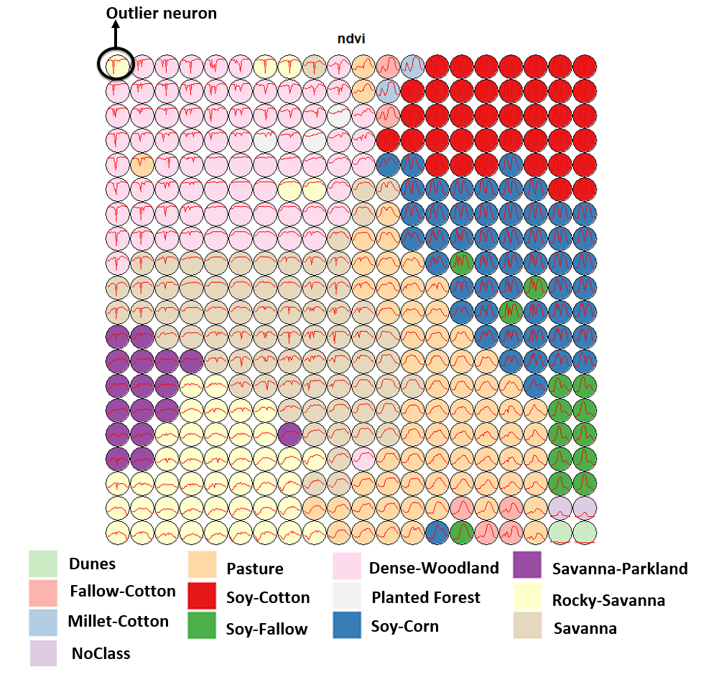
Using SOM to assess sample quality
Alves et al., “Quality control and class noise reduction of satellite image time series”, ISPRS Journal of Photogrammetry and Remote Sensing, vol. 177, pp 75-88, 2021

Slide 17
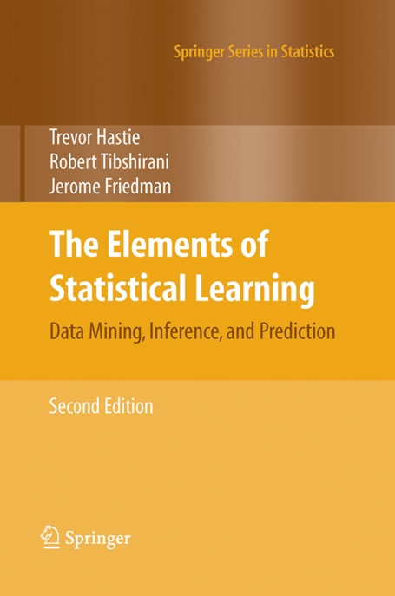
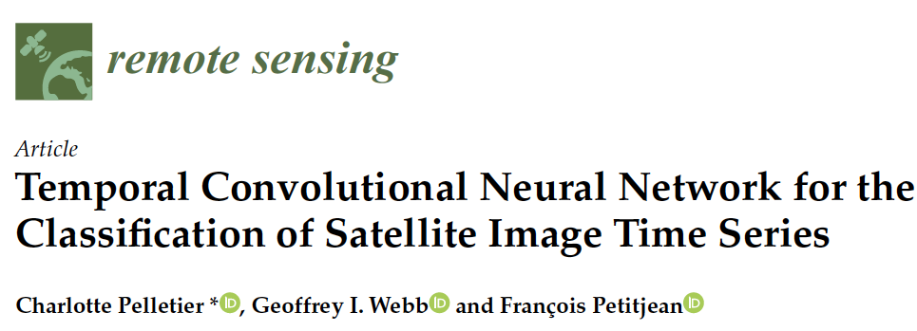
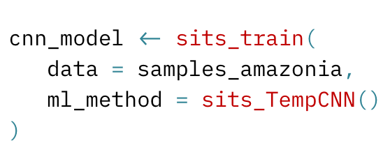

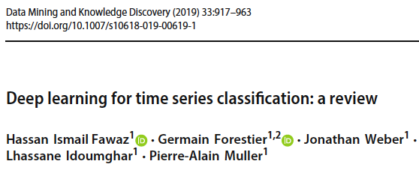
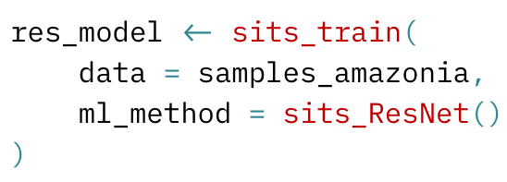
Machine learning and deep learning methods
Notes:
Sits supports different kinds of machine learningand deep learning methods methods, such as random forests, support vector machines, multi-layer perceptrons, temporal convolution neural networks (TempCNN) and InceptionTime described in these research papers and
The user defines the method and its specific parameteres in the sits function “sitis_train” (as you can see here).
========
The first group of methods does not explicitly consider spatial or temporal dimensions;
these models treat time series as a vector in a high-dimensional feature space.
From this class of models, sits includes random forests, support vector machines,
extreme gradient boosting, and multi-layer perceptrons.
The second group of models comprises deep learning methods designed to work
with image time series. Temporal relations between observed values in a time series
are taken into account. Time series classification models for satellite data include 1D
convolution neural networks (1D-CNN), recurrent neural networks (RNN),
and attention-based deep learning. The sits package supports a set of 1D-CNN
algorithms: TempCNN, ResNet, and InceptionTime.
Since sits is aimed at remote sensing users who are not machine learning experts,
the package provides a set of default values for all classification models. These settings
have been chosen based on extensive testing by the authors. Nevertheless, users can
control all parameters for each model. The package documentation describes in detail
the tuning parameters for all models which are available in the respective functions.

Slide 18
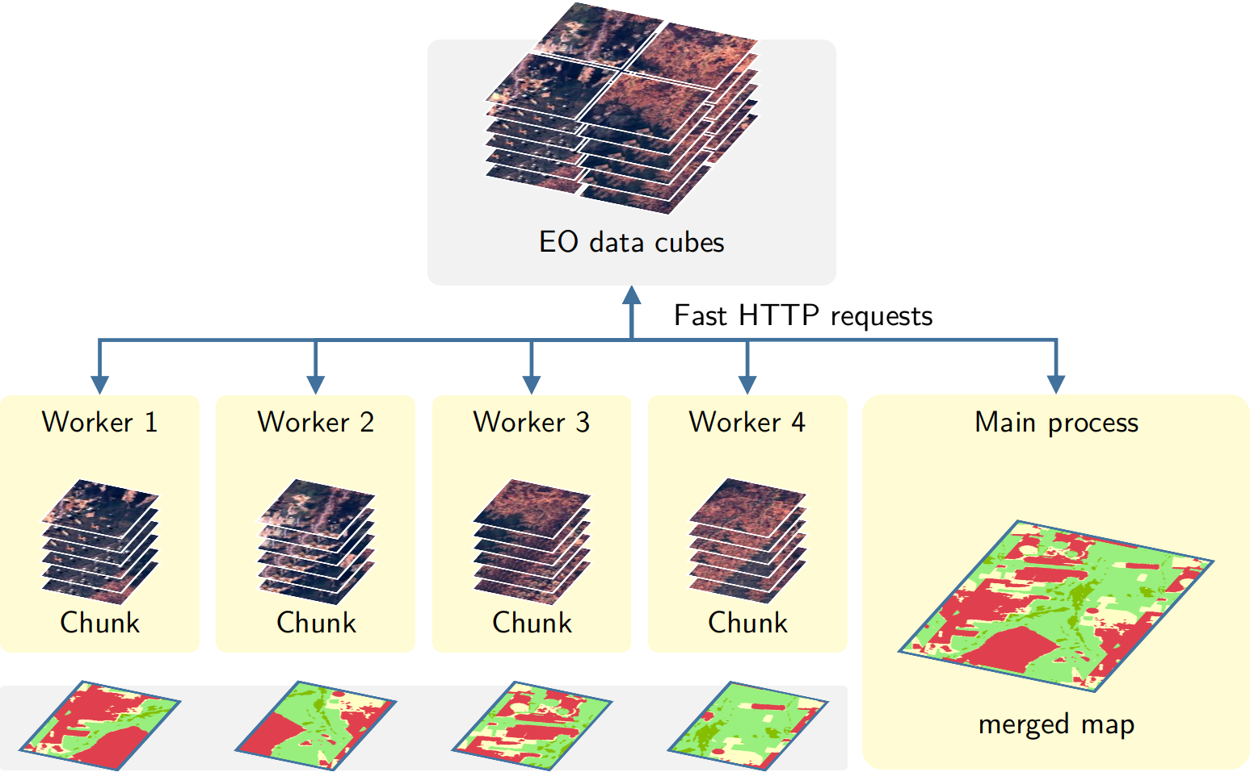
Transparent and efficient parallel processing
Notes:
Image classification in sits is done in parallel.
Sits divides data cubes into chunks and processes them in parallel, based on the number of cores and available memory
defined by the user in the funtion “sits_classify”.
========
, by a cluster of independent workers linked to one or more virtual machines.
The best trade-off has to be determined by the user, considering issues such disk read speed, number of cores in the server, and CPU performance. The memsize parameter controls the size of the main memory (in GBytes) to be used for classification. A practical approach is to set memsize to about 30% of the total memory available.

Slide 19
Bayesian smoothing for post-processing
x_{i}
Neighbourhood: S_{i} and m_{i}
A layer for each label
x_{i}
x_{i}
x_{i}
x_{i}
∑_{i} is provided by user

Slide 20
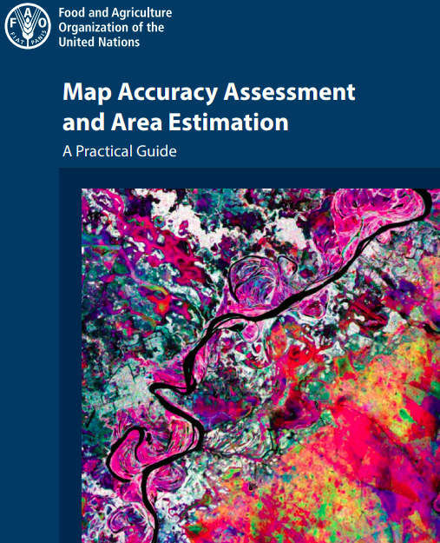
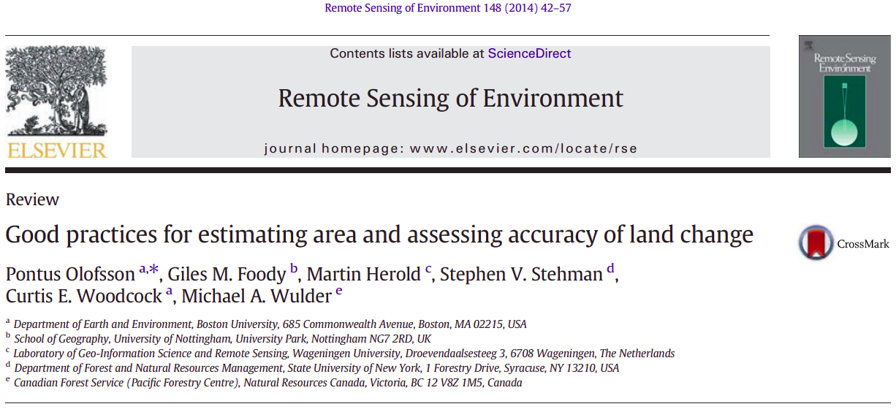
Accuracy assessment supports best practices

Slide 21
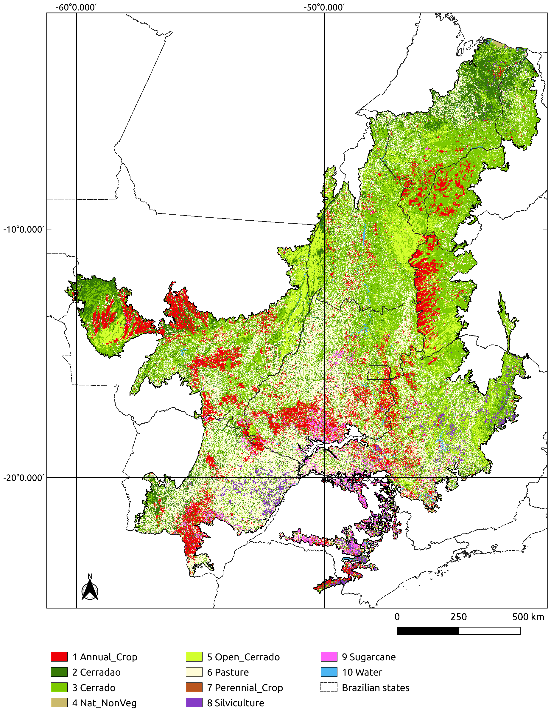
LULC classification
Cerrado biome (200 million ha)
LULC map for year 2018
48,850 samples (TempCNN model)
Landsat-8 16-day time series
8 TB processed in 24 hours
10 LULC classes (86% accuracy)

Slide 22
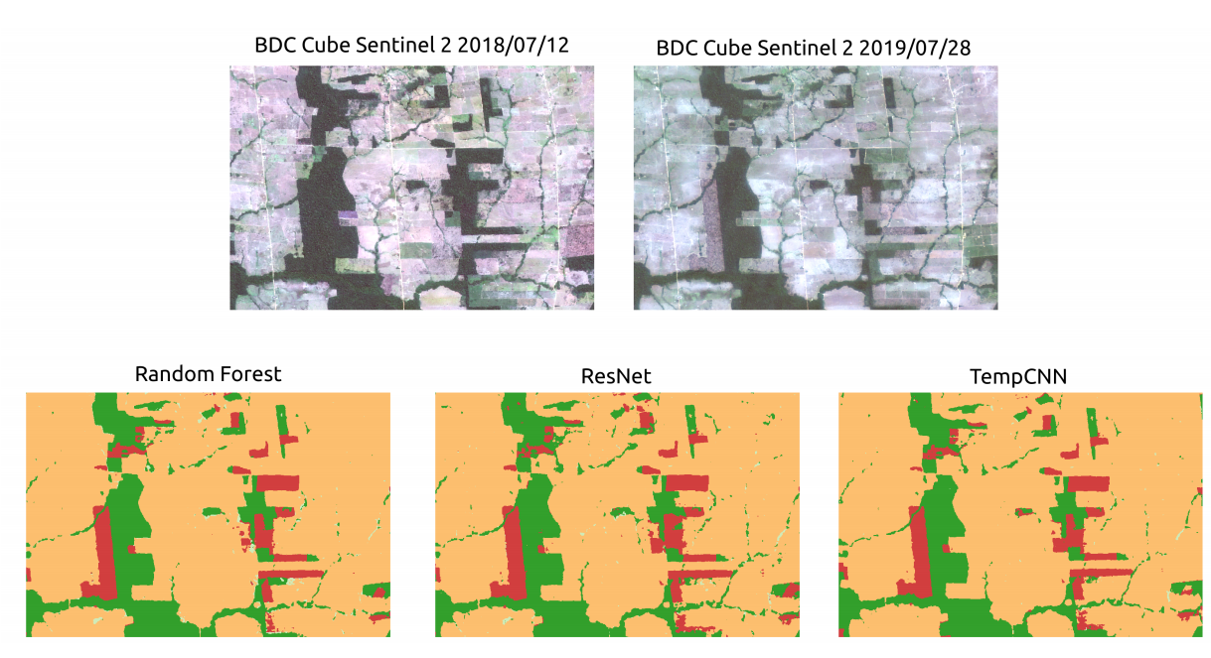
Measuring deforestation using time series
90%
accuracy!
Notes:
These pictures show a region in the Brazilian Amazon forest that was deforested in a certain time between july of 2018 and july of 2019.
Using Sentinel2 data cube and its time series with all available observations between july of 2018 and july of 2019, we can detect this deforestaion using different machine learning methods, Randon Forest, ResNet and TempCNN, with an accuracy of 90%.

Slide 23
Demonstration
https://github.com/e-sensing/sits
https://e-sensing.github.io/sitsbook/

